Slide 1
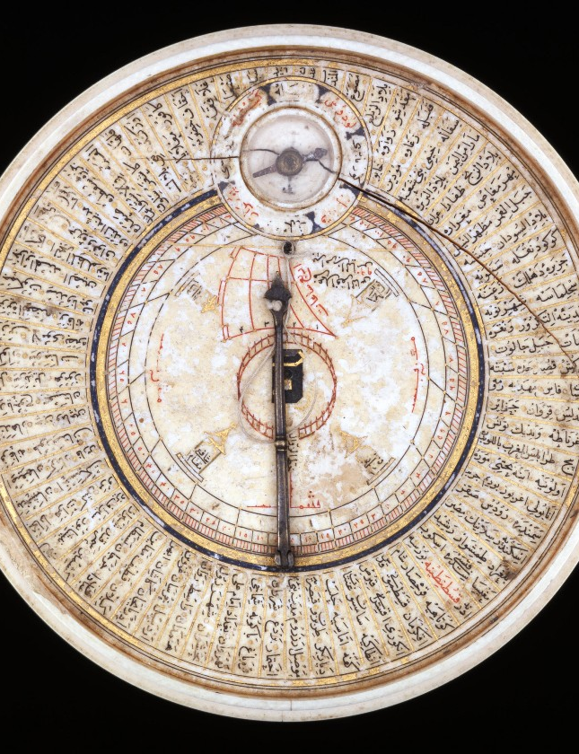

Islamic CSR &
I-CSR Index
Strategies of Building Good & Great Businesses
Mohammad Reevany Bustami
Head, Nusantara Malay Archipelago Research
at the Centre for Policy Research & International Studies (CenPRIS),
Universiti Sains Malaysia (USM) Pulau Pinang.

Slide 2
Islamic CSR & ICSR Index:
Discussion Points…
Kenapa/ Why – CSR, Islamic CSR, I-CSR Index, Social Reporting ?
Bagaimana/ How do we become good and great ?
Apa / What is Islamic CSR (I-CSR) ? How does it transform organizations / businesses ?

Slide 3
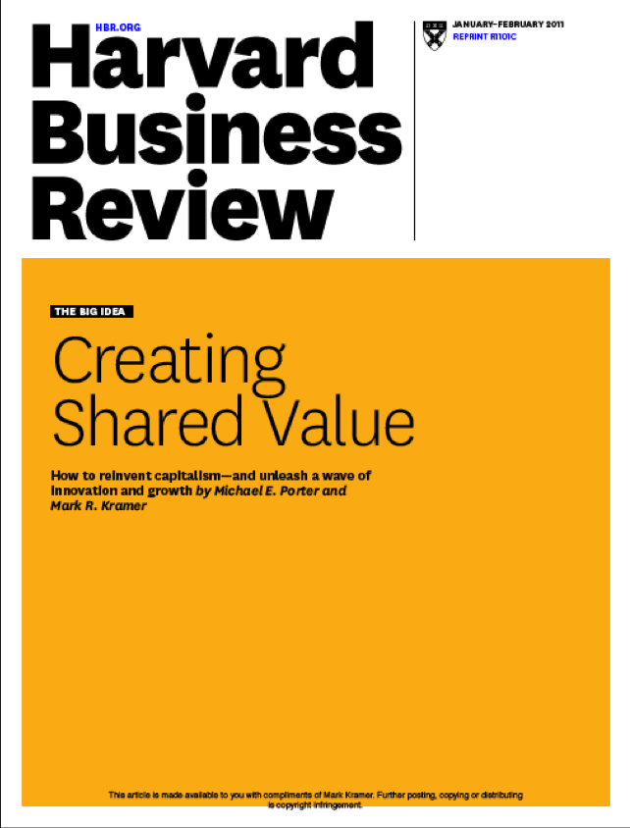
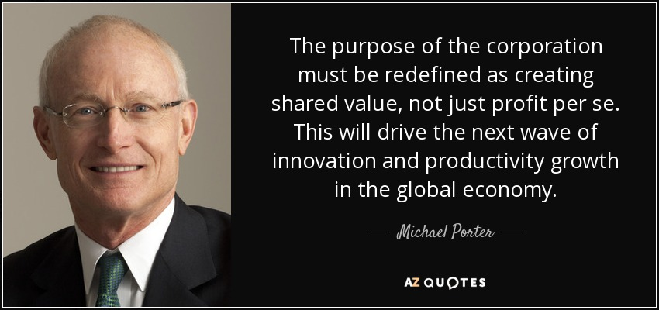
Michael Porter
(& Kramer):
Shared Value
http://genychina.com/wp-content/uploads/2011/10/HBR-Shared-Value-Creation.png
by Mohammad Reevany Bustami reevany@usm.my

Slide 4
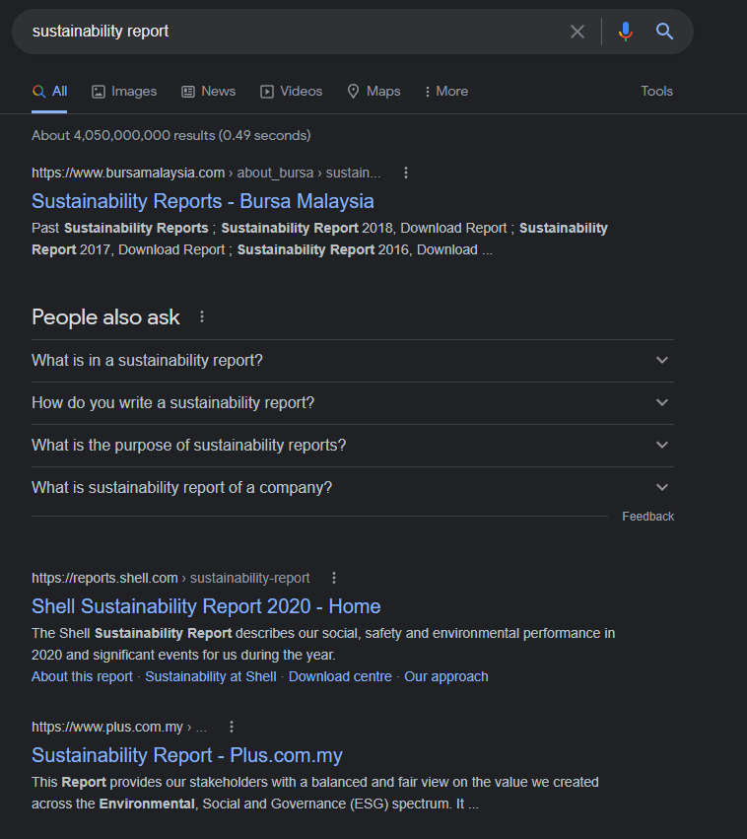
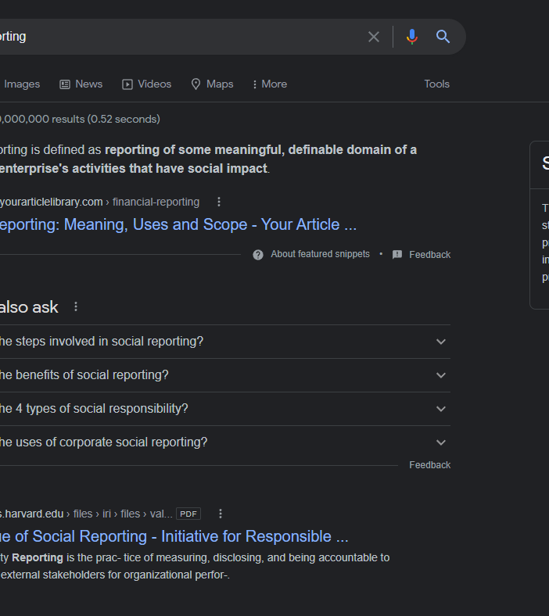
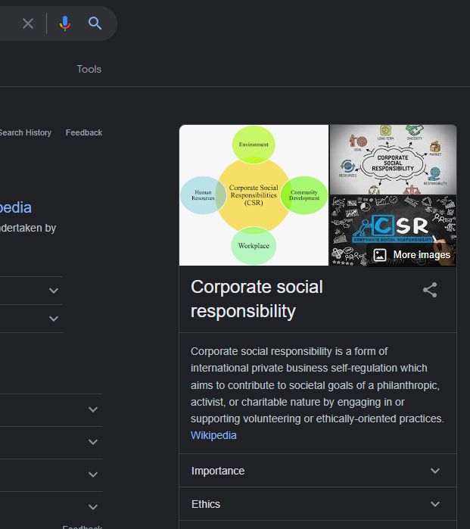
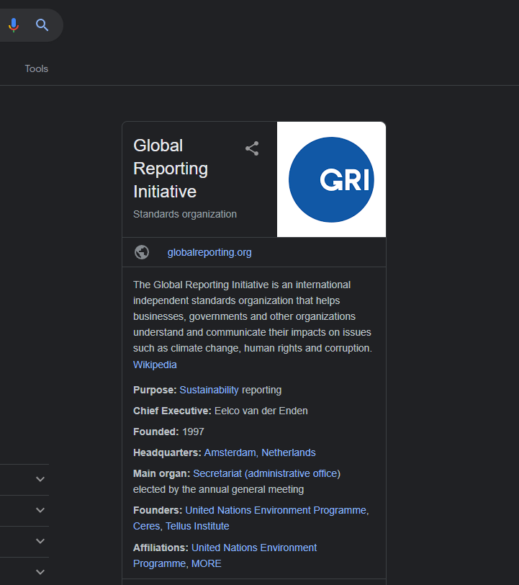
Google Search:
Social Reporting – 7,400,000,000
GRI –
1,900,000,000
CSR –
2,360,000,000
Sustainability Report –
4,050,000,000
WHY?

Slide 5
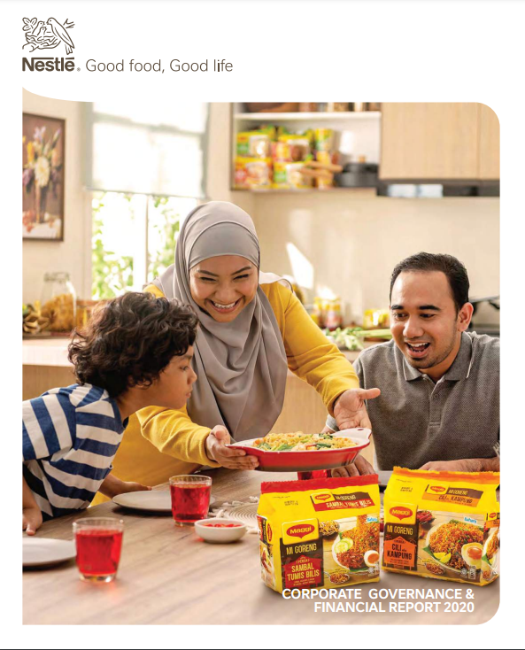



The GLOBAL TREND… 2 Reports
#1.Annual Financial Report + #2.CSR/Sustainability Report
WHY?

Slide 6

CSR & Sustainability-related Labels & Certifications & Standards…
WHY?

Slide 7
Islamic CSR & ICSR Index:
Discussion Points…
Kenapa/ Why – CSR, Islamic CSR, I-CSR Index, Social Reporting ?
Bagaimana/ How do we become good and great ?
Apa / What is Islamic CSR (I-CSR) ? How does it transform organizations / businesses ?

Slide 8
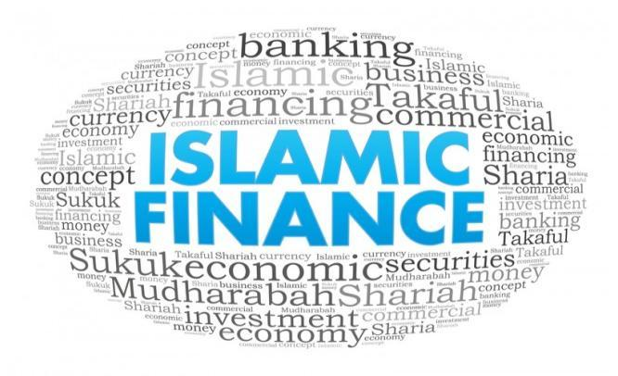


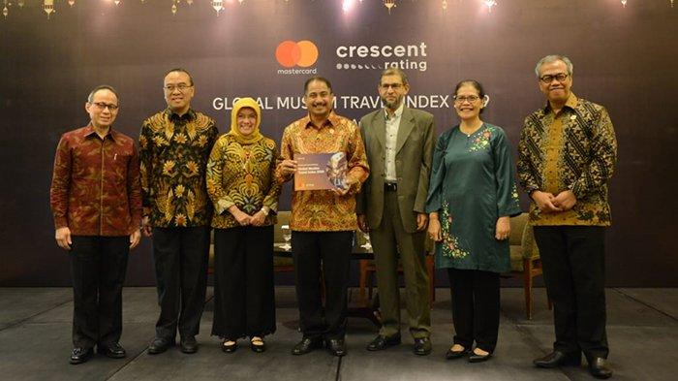

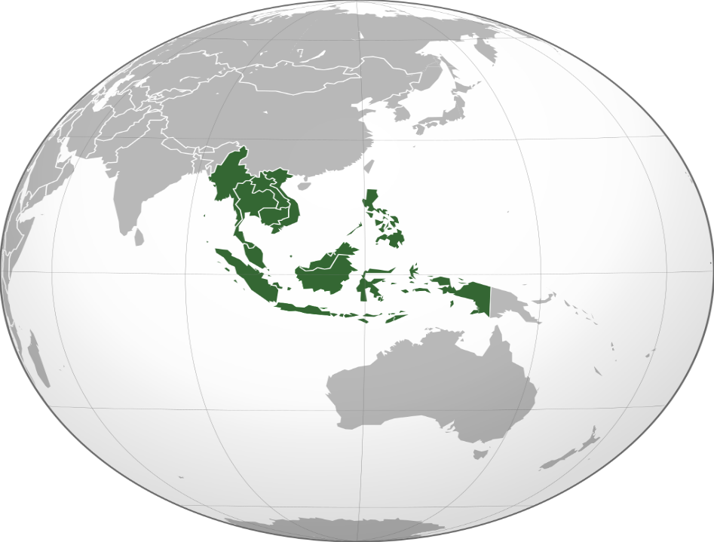



#1. Mencipta Gelanggang+
#2. Applikasi Prinsip Islam +
#3 Membangun Standar & Sistem Audit +
#4.Berbagi Rahmat Sesama Umat +
HOW?
Kita Unggul dalam Gelanggang Keuangan Islam
Kita Unggul dalam
Gelanggang Wisata Islam…
Islamic CSR Principle #6
Authenticity & Credibility:
In Malaysia –
Majority of Customers
are non-Muslims
Kita Unggul
dalam Gelanggang Halal…
#5.Sinergi
Bergabung bersinergi Indonesia + Malaysia …+ [Brunei + Selatan Filipina + Selatan Thailand + Singapura]
Populasi > 350 juta ( = > US)
→Standar yang tinggi / Manfaat bumi-manusia /berEtika
→ dipercayai Rahamatan-lilalamin
→ Nusantara: Raksasa Halalan Toyyiban Global

Slide 9
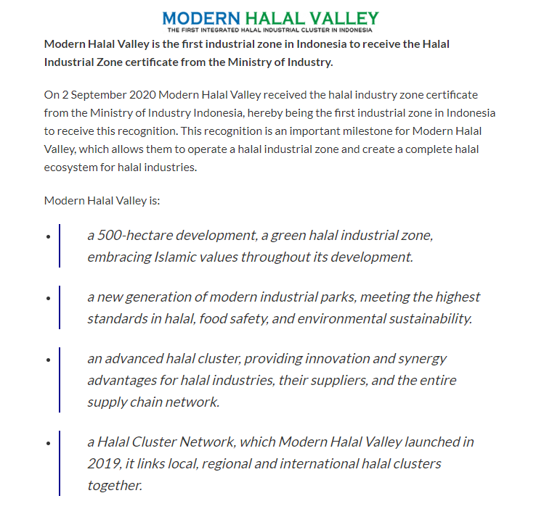
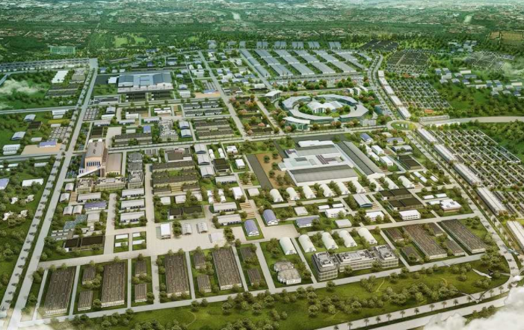
Berbagi Rahmat
sesama Umat
Sejagat
#Mencipta Gelanggang (Luarbiasa) !!
→ Nusantara: Raksasa Halalan Toyyiban Global

Slide 10
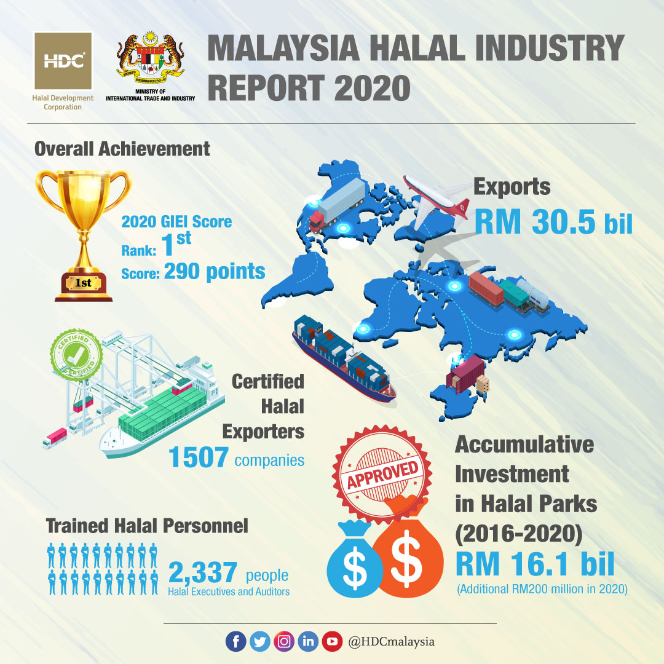
Global Islamic Economic Indicator
https://www.mida.gov.my/mida-news/malaysian-halal-parks-record-rm200-mln-increase-in-direct-investment/
A total of 295 companies are currently in operation throughout the 21 halal parks across Malaysia, with 42 companies (or 14.3%) being multinational corporations (MNCs), while 253 companies (or 85.7%) are locally-owned corporations,
Malaysia recorded an increase of RM0.2 billion (or 1.25%)
At the global arena, Malaysia once again emerged highest in the annual Global Islamic Economy Indicator (GIEI) for year 2020/21, its eighth year in a row, when it came out tops in four out of six categories, including for Halal Food, Islamic Finance, Muslim Friendly Travel, and Pharmaceutical & Cosmetics sectors.
RM9.5 billion (or 59%) is foreign direct investment (FDI) while RM6.6 billion (or 41%) is domestic direct investment (DDI).
#5.Sinergi
→ Nusantara: Raksasa Halalan Toyyiban Global

Slide 11


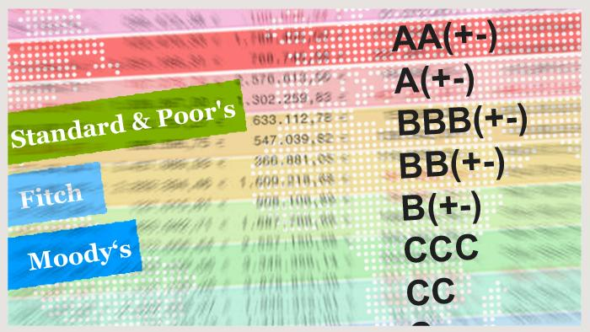
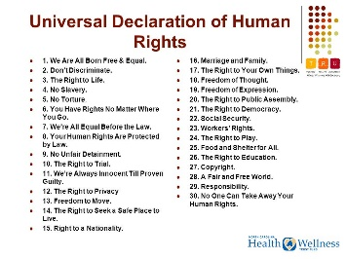
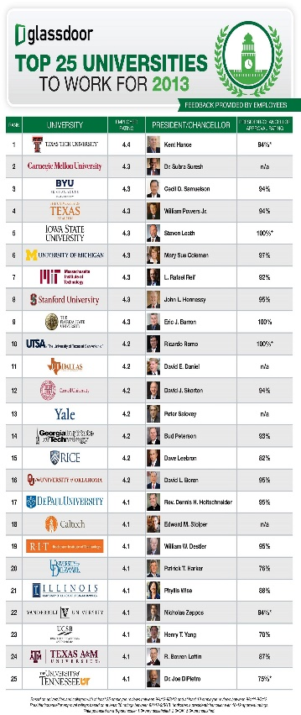

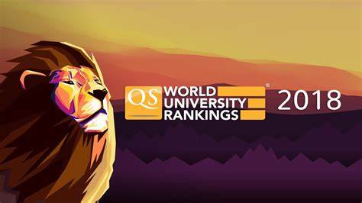


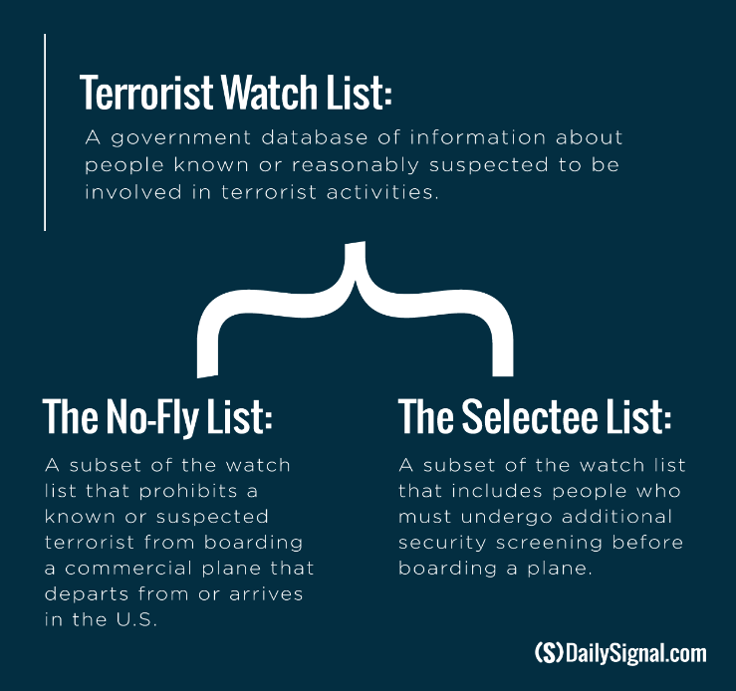


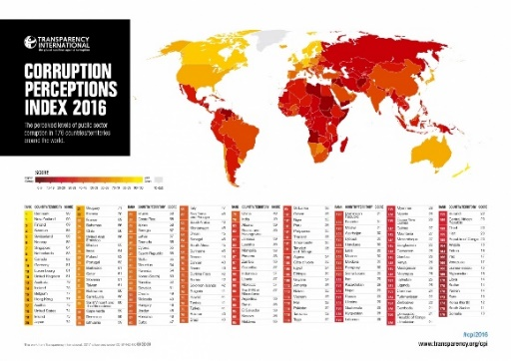
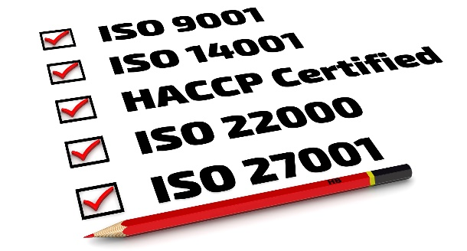

“Those who control standards of right & wrong or good & bad, control the World” – M.R.
Fokus→.Prinsip + Standar

Slide 12


Slide 13

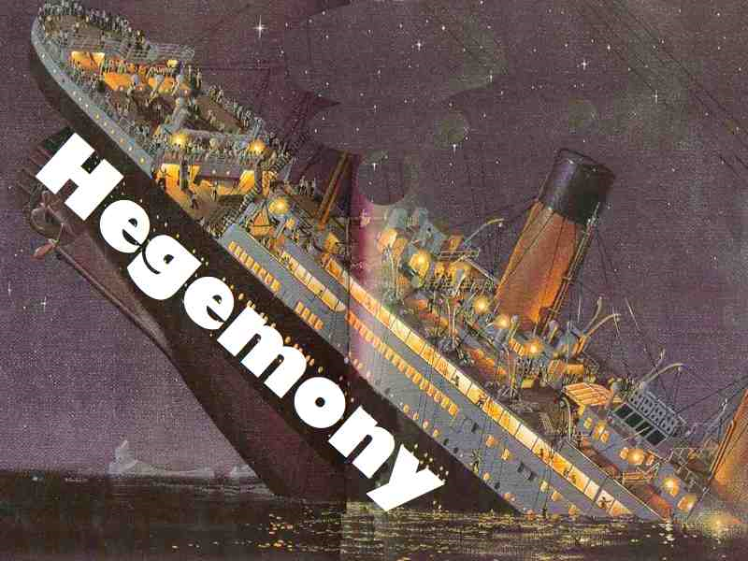
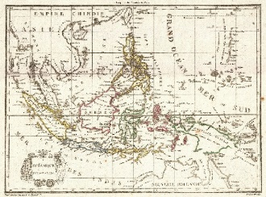
Total Hegemony + Total Sinking
Hegemony of knowledge
Hegemony of Knowledge-Institutions
A Nusantara Scopus? A Nusantara ISI?

Slide 14
Islamic CSR & ICSR Index:
Discussion Points…
Kenapa/ Why – CSR, Islamic CSR, I-CSR Index, Social Reporting ?
Bagaimana/ How do we become good and great ?
Apa / What is Islamic CSR (I-CSR Index) ? How does it transform organizations / businesses ?

Slide 15
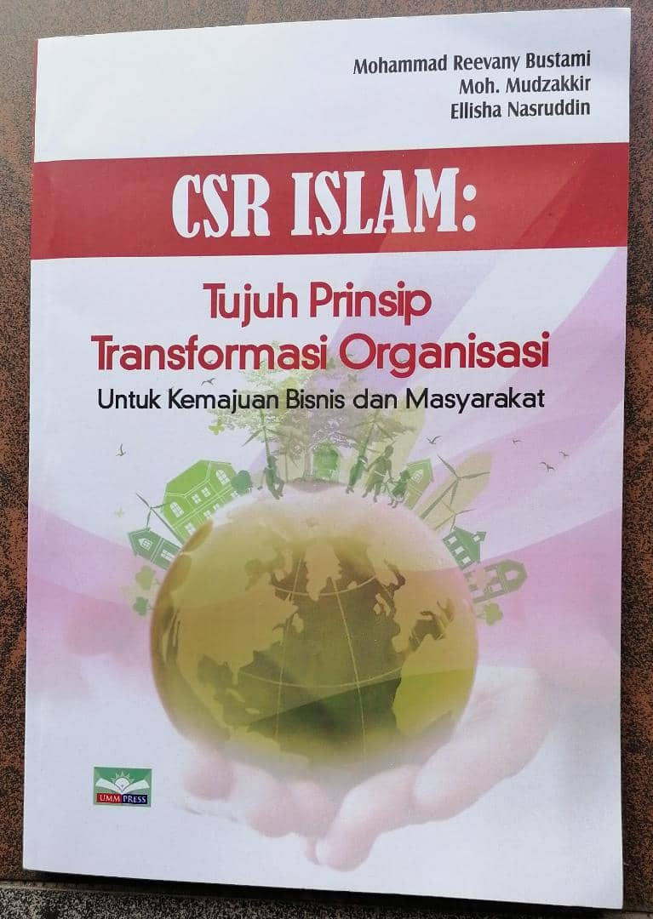

Slide 16

CSR Islam: 7 Prinsip Transformasi
Islamic CSR: 7 Principles of Transformation
1.NIAT YANG BERETIKA
Ethical Intention
2. PENAUANGAN KHALIFAH
Khalifah Stewardship
3. KEJUJURAN & AMANAH
Truthfulness and Trustworthiness
4. HALALAN THAYYIBAN
5. KEADILAN
Fairness
6. OTENTISITAS
DAN KREDIBILITAS
Authenticity
and Credibility
7. DERMA / MEMBALAS
Giving / Reciprocity)
Dari #Prinsip → #Index

Slide 17
Niat: Start with the Golden Rule…
With God and Good Intentions in your Heart
Niat
Investor
Customers
Employees
Community

Slide 18

Pilar Pertama
PRINSIP NIAT YANG BERETIKA
(#1. The Principle of Ethical Intention)
“Sesungguhnya setiap perbuatan tergantung pada niatnya.
Dan sesungguhnya setiap
orang (akan memperoleh)
berdasarkan apa yang
dia niatkan”.
(Nabi Muhammad SAW)
Prepared by Mohammad Reevany Bustami
reevany@usm.my

Slide 19


CSR – generally Externally focused:
Lack internal focus → inner compass
“Reaching out” not “reaching in” /
not anchored to the core of organization
CSR often not linked to organization's Raison d'être (reason for being)
The MOST IMPORTANT STAKEHOLDER
………………………. ………… is still THE SHAREHOLDERS
Vs…… The ALMIGHTY (The Essence of Islamic CSR)
Prepared by Mohammad Reevany Bustami
reevany@usm.my

Slide 20
Pillar #1: Principle of Ethical Intention
Ethical Rationality /Ethical re-purposing
“To do the right thing for the right reasons”
Check the Intention (Niat) underlying
the business existence - Ethical Re-Purposing of Business
Why is your business here?
What is the purpose of your business?
What is your business about?
Niat (Bahasa and نیّة in Arabic) is a concept referring to the intention one evokes in one's heart to do an act
for the sake of God (Allah) or otherwise.
So, in Islam, niat must precede an act,
as an act without a niat may not be not counted.
‘Umar b. al-Khattab narrated that the Prophet (S) said: “Deeds are [a result] only of the intentions [of the actor], and an individual is [rewarded] only according to that which he intends. Therefore, whosoever has emigrated (hijrah) for the sake of Allah and His messenger, then his emigration was for Allah and His messenger. Whosoever emigrated for the sake of worldly gain, or a woman [whom he desires] to marry, then his emigration is for the sake of that which [moved him] to emigrate.” -- Narrated by Bukhari and Muslim.
by Mohammad Reevany Bustami reevany@usm.my

Slide 21

(cont.) Pillar #1:
Principle of Ethical Rationality /
Ethical re-purposing
How can the business provide an
ETHICAL LEADERSHIP?
Rectifying the ‘sins’/ ‘mistakes’ of the industry:
Turn problems of the industry into a strategic ethical purpose
‘Umar b. al-Khattab narrated that the Prophet (S) said: “Deeds are [a result] only of the intentions [of the actor], and an individual is [rewarded] only according to that which he intends. Therefore, whosoever has emigrated (hijrah) for the sake of Allah and His messenger, then his emigration was for Allah and His messenger. Whosoever emigrated for the sake of worldly gain, or a woman [whom he desires] to marry, then his emigration is for the sake of that which [moved him] to emigrate.” -- Narrated by Bukhari and Muslim.
by Mohammad Reevany Bustami reevany@usm.my

Slide 22

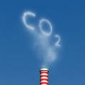


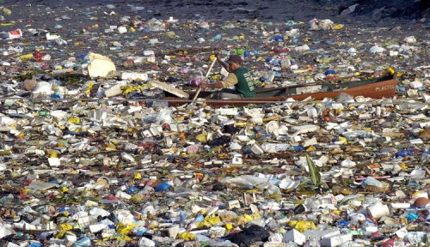



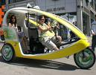

Providing CSR Leadership through
Industrial Rectification
Key Questions: What’s wrong (the sins) with your industry?
How to apply CSR leadership to rectify these mistakes/ weaknesses?
biodegradable polymer material
…compost in 3 months
https://thebrightestman.wikispaces.com/file/view/Animal_Testing_Addbuster_by_mlndls.jpg
Emission-free car?
Prepared by Reevany Bustami
cptagusm@gmail.com,, reevany@usm.my

Slide 23


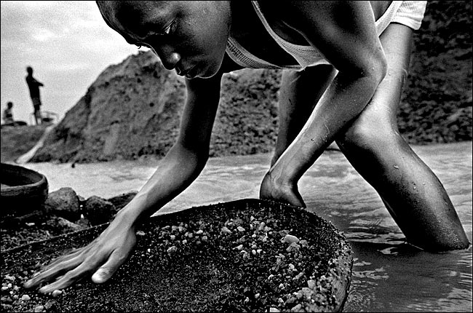
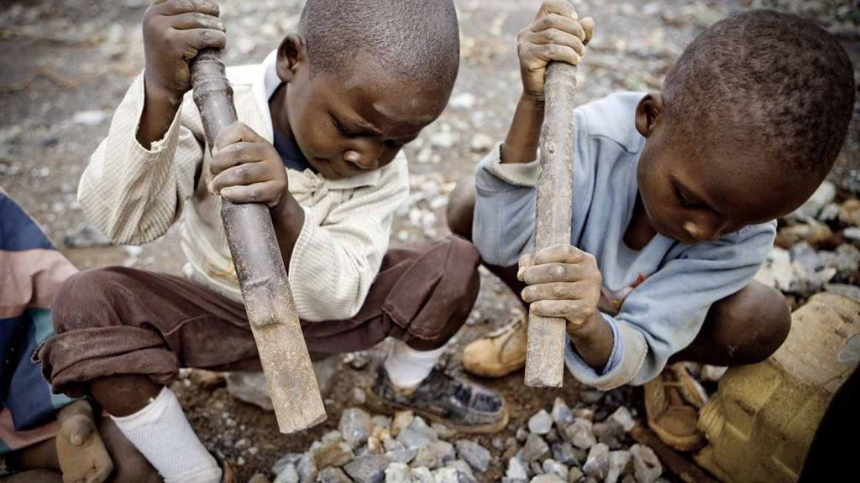
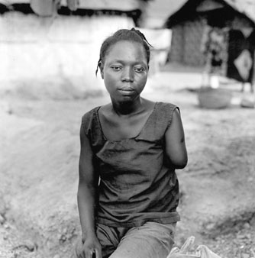

Slide 24
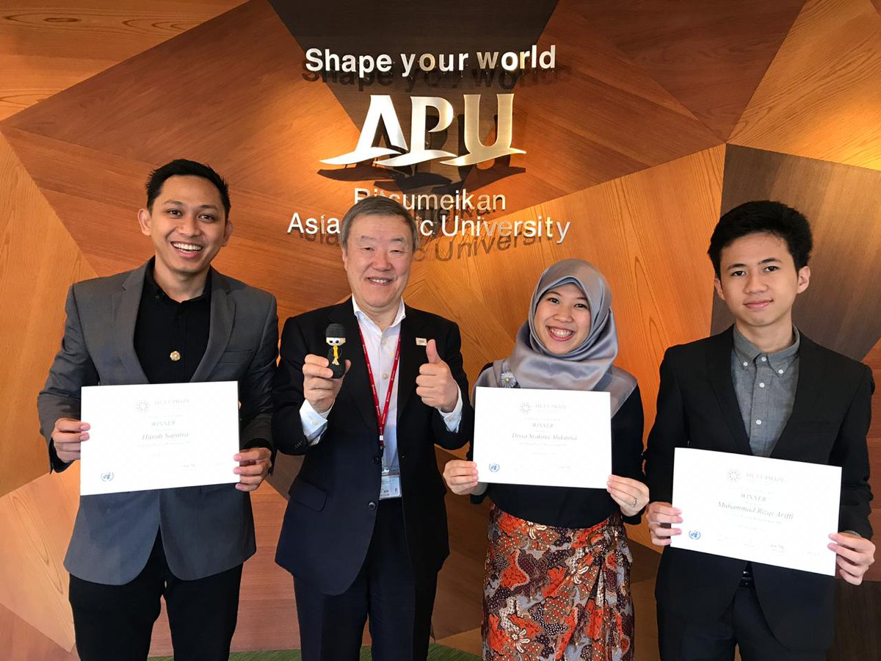
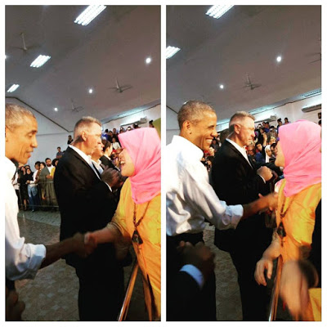
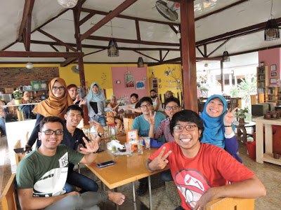
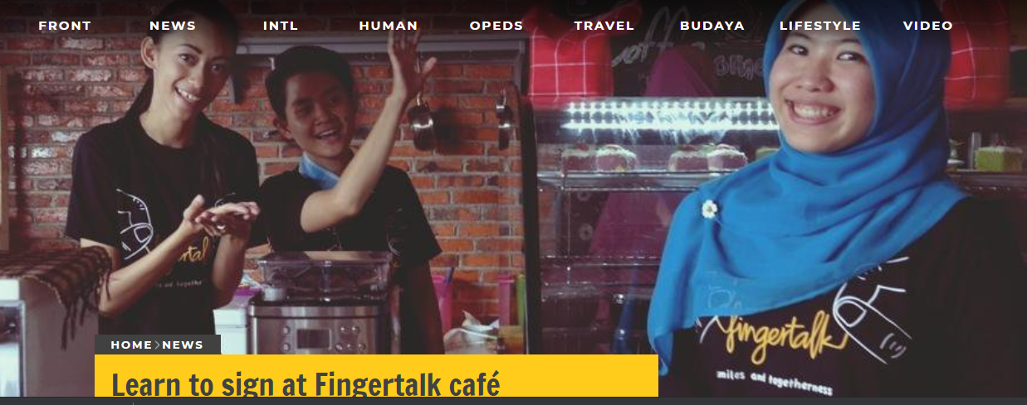
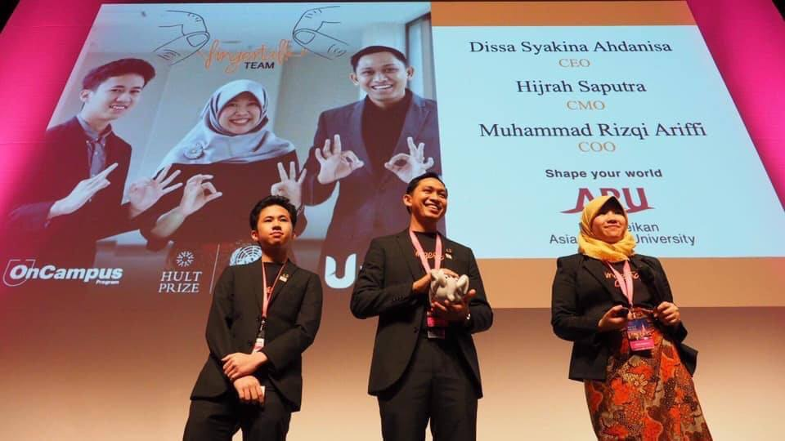

Slide 25
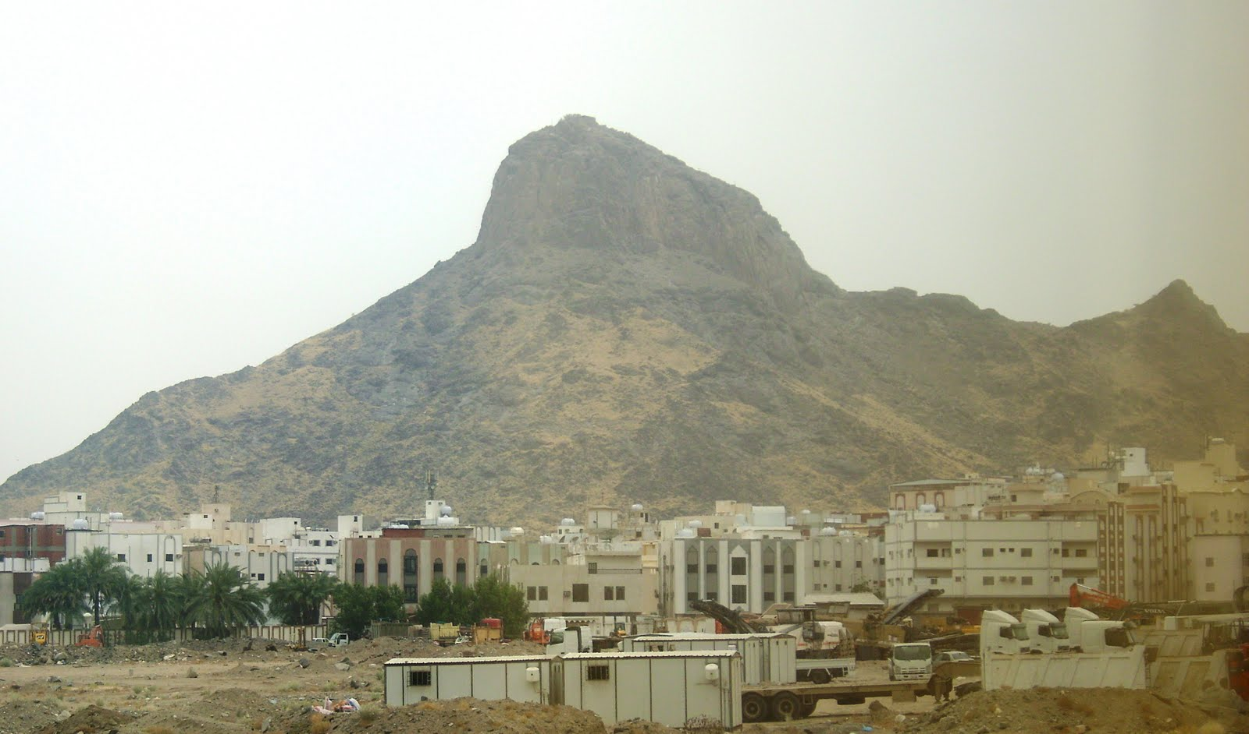
(cont.) Pillar #1:
Principle of Ethical Rationality /
Ethical re-purposing
Bisnis sebagai satu
Ibadah yg BerMISI
1. The Essence (Purpose) : The purpose is to have an Ethical / right reason(s) for starting and sustaining your business
2. The Benefits:
It provides a higher purpose for organization & its people & its external stakeholders
It can differentiate the organization in a ethical and strategic manner
It demonstrates (ethical) leadership
It directs actions and becomes a measure of success – functioning like a organizational compass
‘Umar b. al-Khattab narrated that the Prophet (S) said: “Deeds are [a result] only of the intentions [of the actor], and an individual is [rewarded] only according to that which he intends. Therefore, whosoever has emigrated (hijrah) for the sake of Allah and His messenger, then his emigration was for Allah and His messenger. Whosoever emigrated for the sake of worldly gain, or a woman [whom he desires] to marry, then his emigration is for the sake of that which [moved him] to emigrate.” -- Narrated by Bukhari and Muslim.
by Mohammad Reevany Bustami reevany@usm.my

Slide 26
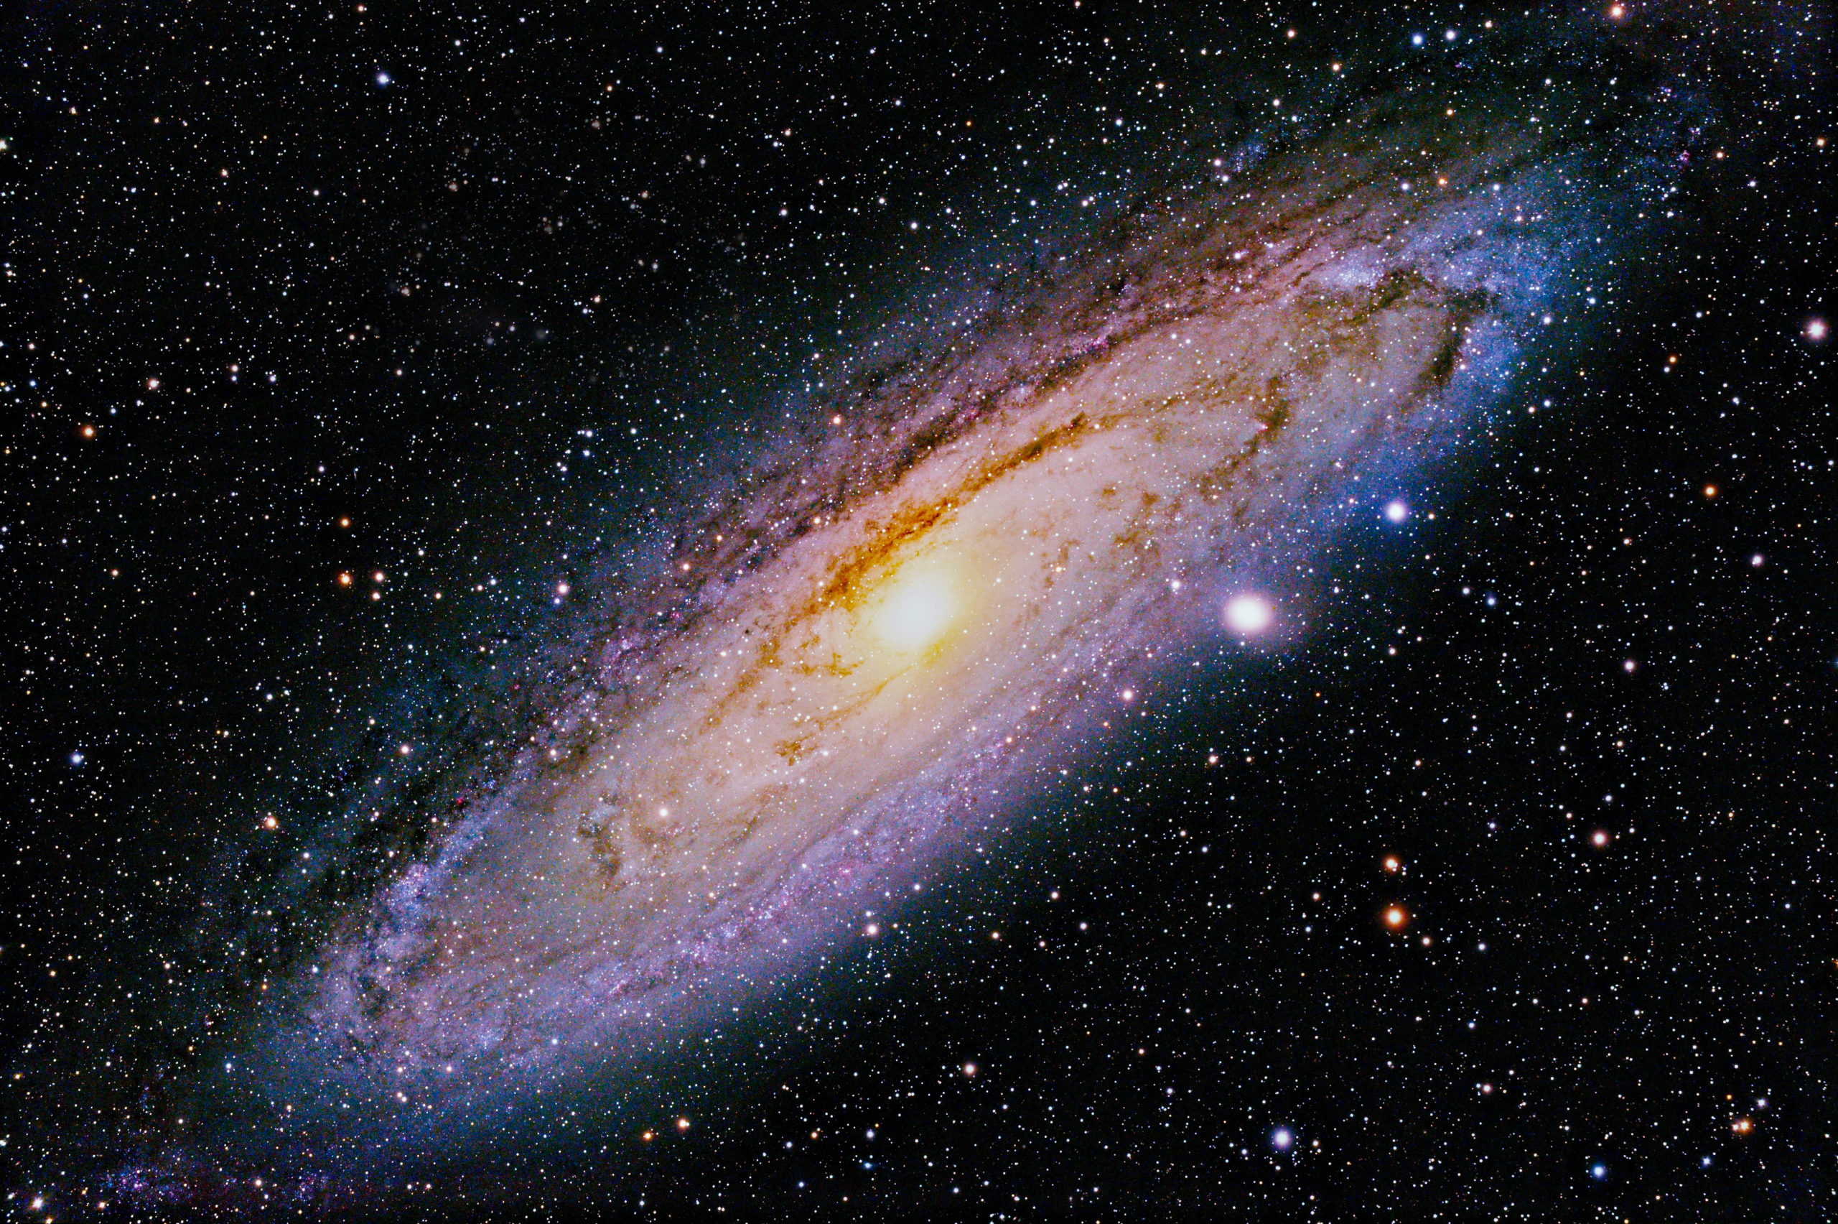
Pilar Kedua:
PRINSIP PENAUNGAN KHALIFAH
(#2. Principle of Khalifah Stewardship)
“Kita awal mulanya makhluk rohani,yang kemudian diberi jasad fisik oleh Tuhan dengan tugas menghamba kepada-Nya dan menjadi khalifah untuk kebaikan alam semesta.
Kalau kedua peran ini bisa kita jalankan, aku yakin manusia dalam puncak bahagia”
(Ahmad Fuadi dalam Novel Satu Muara)
https://www.scienceworld.ca/stories/how-old-is-our-universe/

Slide 27
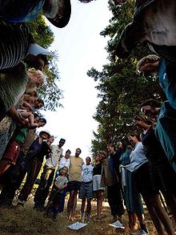
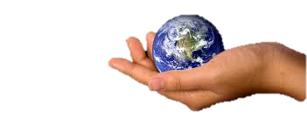
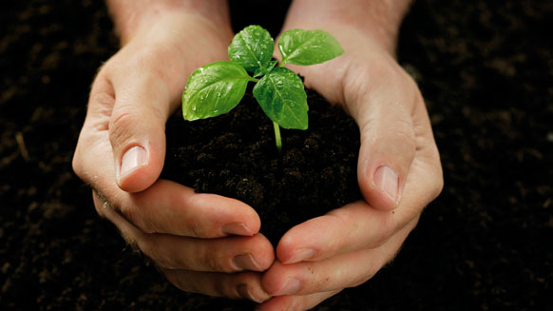
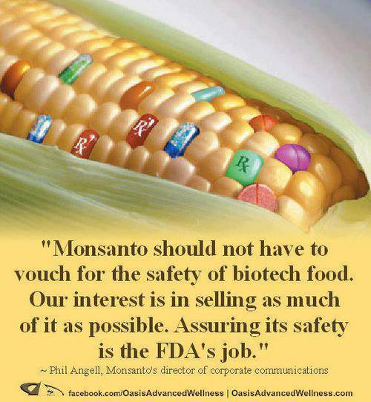
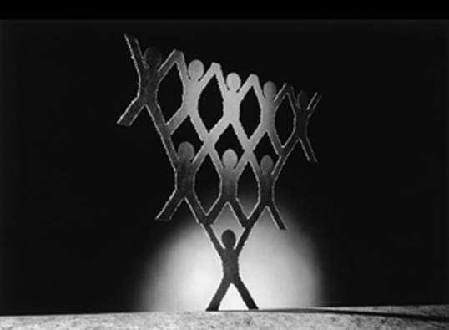
Pillar #2:
Prinsip
Penaungan Khalifah
Principle of Khalifah Stewardship
1.Tanggungjawab Komunitas
Community Responsibility
towards various Stakeholders –
What are the responsibilities/ obligations? ?
2.Tanggungjawab Lingkungan
Environmental Responsibility
3.Tanggungjawab Tempat Kerja
Workplace responsibility
4.Tanggungjawab
Produk & Jasa
Product & Service Responsibility
by Mohammad Reevany Bustami reevany@usm.my

Slide 28
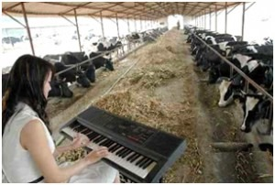
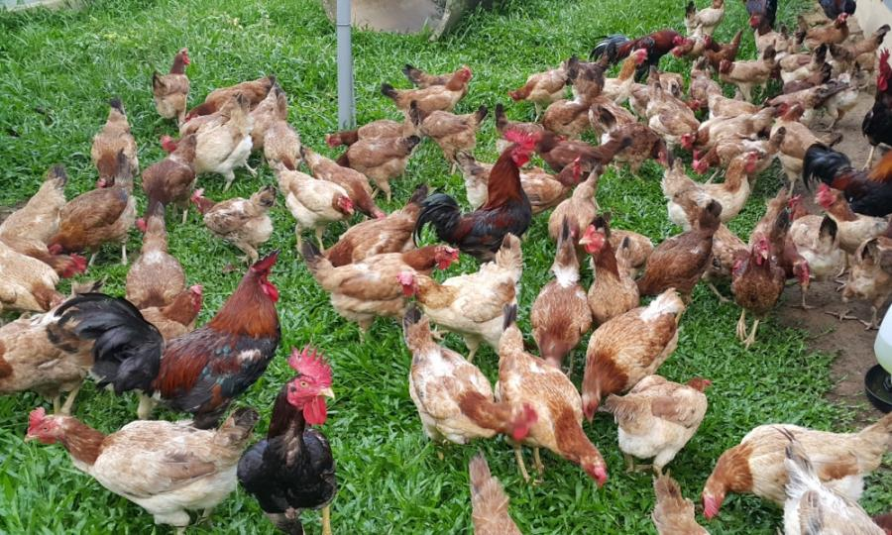
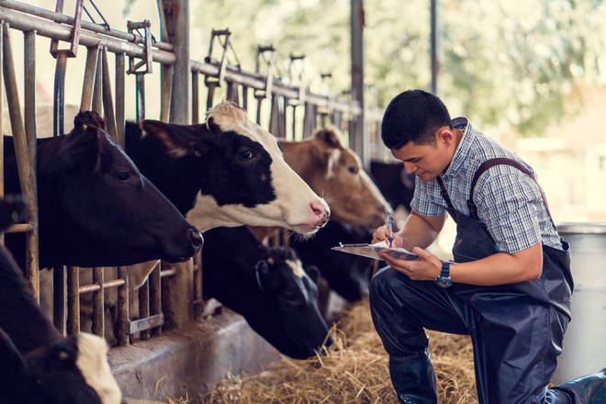
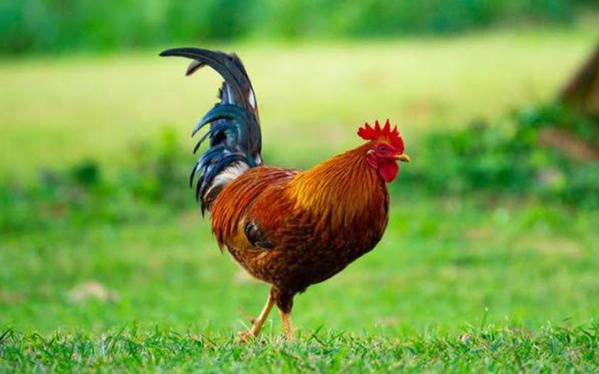
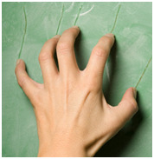
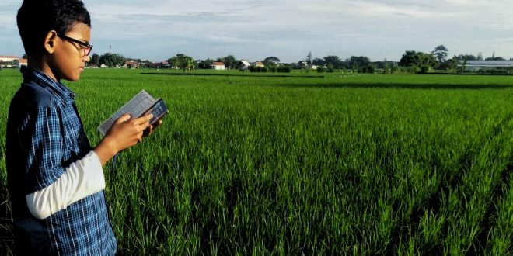
Khalifah’s Product Responsibility

Slide 29
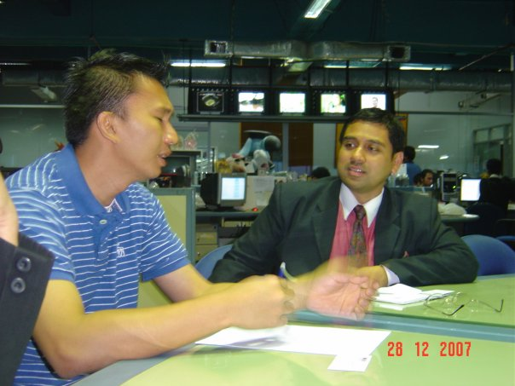
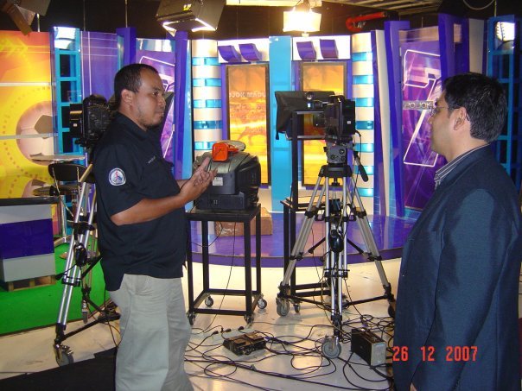

Khalifah’s Community Responsibility
by Mohammad Reevany Bustami reevany@usm.my

Slide 30


Environmental Responsibility

Slide 31


Khalifah’s Workplace Responsibility:
Employer of the Year - Vietnam

Slide 32





Employees choosing
their own CSR…duta perusahaan

Slide 33



Ruang Umum CSR…

Slide 34

Bongkarkan kebiasaan lama !
Change the bad.. Champion the good.

Slide 35

Pilar Ketiga
PRINSIP KEJUJURAN & AMANAH
(#3. Principle of Truthfulness and Trustworthiness)
“Kedua orang penjual dan pembeli masing-masing memiliki hak pilih (khiyar) selama keduanya belum berpisah. Bila keduanya berlaku jujur dan saling terus terang, maka keduanya akan memperoleh keberkahan dalam transaksi tersebut.
Sebaliknya, bila mereka berlaku dusta dan saling menutup-nutupi, niscaya akan hilanglah keberkahan bagi mereka pada transaksi itu.”
(Nabi Muhammad SAW)
by Mohammad Reevany Bustami reevany@usm.my

Slide 36





Trust through Low Price
But Same Quality
الأمين
Tell the truth about:

Slide 37
Pillar #3:
Principle of Truthfulness/ Trustworthiness
Total Truth: Prophet’s practice of disclosing the cost
What’s the impacts of the business operations, practices and products on the various stakeholders?
“The seller and the buyer have the rights to return the goods as long as they have not parted or till they parted;
and if both parties spoke the truth and describe the defects and qualities (of the goods),
then they would be blessed in their transaction; and if they told lies or hid something,
then the blessings of their transaction will be lost.”
-Prophet Muhammad s.a.w (Hadith Bukhari No. 1937)
Supply-chain / production process disclosure
by Mohammad Reevany Bustami reevany@usm.my

Slide 38

Pilar Keenam
PRINSIP OTENTISITAS
DAN KREDIBILITAS
(#6. Principle of Authenticity and Credibility)
“Hai orang-orang yang beriman, apabila kamu bermu'amalah tidak secara tunai untuk waktu yang ditentukan, hendaklah kamu menuliskannya. Dan hendaklah seorang penulis di antara kamu menuliskannya dengan benar…..
(Q.S Al Baqarah; 282)
https://lambchow.com/wp-content/uploads/2021/01/art-quill-pen-writing-instrument-accessory-feather-writing-1593135-pxhere.com_.jpg
by Mohammad Reevany Bustami reevany@usm.my

Slide 39
Pillar #6: Principle of
Authenticity & Credibility
Documentation, (Audit) Verification and Certification
Documenting is one of the MOST Powerful Islamic Traditions & Practices
Credible Sourcing and verification / certification (e.g. hadith) Verification and Acceptance
Role of independent bodies/ regulators / Universities / Academics/ NGOs
by Mohammad Reevany Bustami reevany@usm.my

Slide 40


Establish Our Own ICSR Index
Our Own Ethical Compass and Transform our Businesses and Organizations
https://www.theartsdesk.com/visual-arts/hajj-journey-heart-islam-british-museum
Terima kasih reevany@usm.my
What is the Direction of your action ?
Do you have a Compass to get there?
Whose / What compass are you using?

Slide 41

Pilar Keempat
PRINSIP HALALAN THAYYIBAN
(#4. Principle of Halalan Thayyiban)
“Hai sekalian manusia, makanlah yang halal lagi baik (thayyib) dari apa yang terdapat di bumi, dan janganlah kamu mengikuti langkah-langkah setan; karena sesungguhnya setan itu adalah musuh yang nyata bagimu.”
(Q.S Al-Baqarah: 168)
https://ansarcomp.com.my/index.php/2019/11/08/halalan-toyyiban/
“Hai sekalian manusia, makanlah yang halal lagi baik (thayyib) dari apa yang terdapat di bumi, dan janganlah kamu mengikuti langkah-langkah setan; karena sesungguhnya setan itu adalah musuh yang nyata bagimu.”
(Q.S Al-Baqarah: 168)

Slide 42
Pillar #4:
Principle of Halalan-Thayyiban
Do No Harm + Do No Haram
Islamic Hippocratic rule
Halal + Good
by Mohammad Reevany Bustami reevany@usm.my

Slide 43
Story / Illustration of a
“halal” chicken
- By Mohammad Reeza Bustami & Mohammad Reevany Bustami
by Mohammad Reevany Bustami reevany@usm.my

Slide 44
Accessible to outdoors
Organic feed
Balanced diet
Halal & Tayyiban
chicken
Chicken being slaughtered
Slaughtered chicken becomes HALAL
GOOD to consume
May NOT be GOOD to consume
antibiotics
Chemicals/ fertilizers
Pesticides/ incecticides
Halal (alone)
Growth hormones
knife
Story & Illustration of “halal” chicken
- By Mohammad Reeza Bustami & Mohammad Reevany Bustami
by Mohammad Reevany Bustami reevany@usm.my

Slide 45






Harm? Haram?
http://www.kickthemallout.com/article.php/Story-Scoop_On_Melamine_Food_Poisoning
China sells melamine-contaminated products. http://husaria.wordpress.com/2008/11/16/got-melanin/
Melamine was once used to make plates and kitchenware, but it can be used to mimic proteins in milk and foodstuff — hence this year's big "Made in China" scandal. There had been a preview of Melamine's dangers in 2007, when dogs and cats around the world suffered kidney failure because they weren't able to process the compound, which is not poisonous but cannot be broken down by the body. Melamine had been secreted into pet food manufactured in China to make it appear more nutritious. In 2008, the victims were babies. Six Chinese infants died from kidney failure, while close to 300,000 were hospitalized. One company apologized on Sept. 15, but melamine was an open-secret ingredient in the Chinese food industry, and the panic went global because of the ubiquity of Chinese food exports. Melamine has been found in animal feed and eggs, even sex toys. (Sept. 15)
http://www.en8848.com.cn/Article/Life/lifestyle/60416.html
In August 2008, China Sanlu Milk Powder tested positive for Melamine In 2007, US cats and dogs died suddenly. It was found that their pet food from China contained Melamine. Early in 2008, in China , an abnormal increase in infant cases of kidney stones was reported.
Prepared by Reevany & Eleesya
cptagusm@gmail.com,, reevany@usm.my, ellisha@usm.my

Slide 46

Pilar Kelima
PRINSIP KEADILAN
(#5.Principle of Fairness)
Sesungguhnya Allah menyuruhmu menyampaikan amanah kepada yang berhak menerimanya. Dan apabila kamu menetapkan hukum (kebijakan) di antara manusia, hendaknya kamu menetapkannya dengan adil. Sesungguhnya Allah sebaik-baik yang memberi pengajaran kepadamu. Sungguh, Allah Maha Mendengar lagi Maha Melihat.
(Q.S An-Nisa: 58)
by Mohammad Reevany Bustami reevany@usm.my

Slide 47





Pillar #5:
Principle of Fairness (Adil)
http://www.canow.org/canoworg/images/2008/04/21/pay_euity.jpg
http://todercan.com/wordpress/wp-content/uploads/london-protests.jpg
Fair distribution of wealth … supply chain….?
….Gender equality…?
…. Management and workers…? ….Consumers…? Small NGOs…?
….Indigenous rights & position ?
Prepared by Reevany Bustami
cptagusm@gmail.com,, reevany@usm.my
http://news.brown.edu/files/images/Nunn2.large.jpg

Slide 48
Fairness to Indigenous community
by Mohammad Reevany Bustami reevany@usm.my

Slide 49

Pillar Ketujuh
PRINSIP DERMA / MEMBALAS
(#7.Principle of Giving / Reciprocity)
“Kamu sekali-kali tidak sam­pai kepada kebajikan, sebelum kamu menafkahkan sebahagian harta yang kamu cintai. Dan apa saja yang kamu nafkahkan maka sesungguhnya Allah mengetahuinya.” (QS.Ali Imran [3] :92).

Slide 50

Pillar #7: Principle of Giving & Reciprocity
Zakat + Sedeqah + Hadiah + Giving back
+ Waqaf = the Gift that keeps on giving
(“Jihad Bisnis/Ekonomi ) …………………….. /
Jihad Bisnis”)
“Strategi dan sejata paling penting ialah menjadikan bisnis suatu Jihad… Teras ekonomi Khalifah ialah menjana harta kekayaan dan membina
kuasa ekonomi ummah.”
by Mohammad Reevany Bustami reevany@usm.my

